Slide 1
Unit Four

Slide 2
1 Alliance: a joining together for some common purpose; pact, coalition
Unit 4
Noun
The two nations formed an alliance to defend each other in case of attack.

Slide 3
2. Bewilder: to puzzle completely, confuse, baffle, perplex
Unit 4
Verb
The teacher continues to bewilder her students by giving contradictory directions.

Slide 4
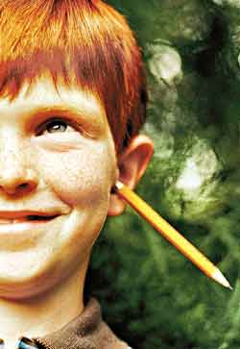
3. Buffoon: a clown; a coarse, stupid person, fool
Unit 4
Noun
Some students think that they need to play the buffoon in order to entertain their classmates.

Slide 5
4. Controversial: arousing argument, dispute, or disagreement, arguable, debatable
Unit 4
Adjective
The school board waited until all members were present before issuing the controversial proposal to ban after-school programs.

Slide 6
5. Dishearten: to discourage, dismay, demoralize
Unit 4
Verb
Do not let your low score on the math test dishearten you.

Slide 7
6. Fruitless: not producing the desired results, unsuccessful; useless, unproductive, futile
Unit 4
Adjective
When their efforts to fight the infection with penicillin proved fruitless, the doctors tried a different antibiotic.

Slide 8
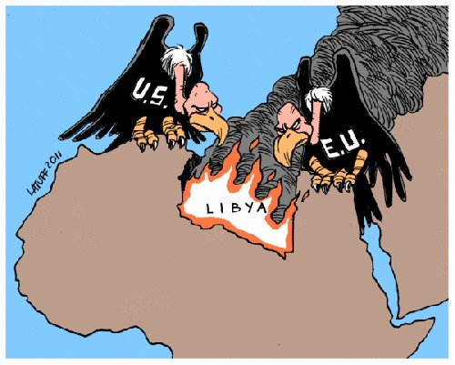
7. Hostile: unfriendly; unfavorable; warlike, aggressive
Unit 4
Adjective
Relations between the nations have been hostile for decades.

Slide 9
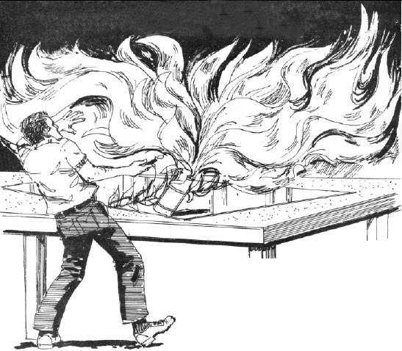
8. Inflammable: easily set on fire, combustible, flammable; easily angered or aroused
Unit 4
Adjective
Always be cautious when using inflammable cleaning solvents.

Slide 10
9. Inflict: to give or cause something unpleasant, impose, deal out, visit upon
Unit 4
Verb
Despite all the jokes, doctors do not like to inflict pain on their patients.

Slide 11
10. Malignant: deadly, extremely harmful, lethal, evil; spiteful, malicious
Unit 4
Adjective
Much to the patient’s relief, the X ray revealed no malignant growth.

Slide 12
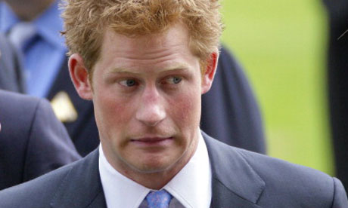
11. Mortify: to hurt someone’s feelings deeply; to cause embarrassment or humiliation; humiliate, embarrass
Unit 4
Verb
The teacher was mortified by the students’ childish behavior on the field trip.

Slide 13
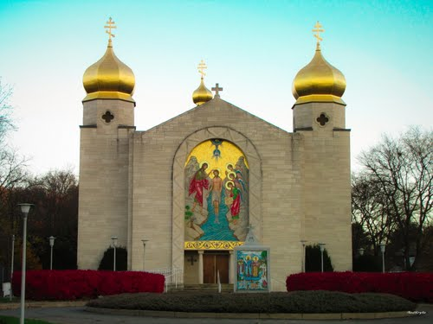
12. Orthodox: in agreement with established or generally accepted beliefs or ways of doing things; traditional, customary
Unit 4
Adjective
Our principal, who believes in proven teaching methods, takes an orthodox approach to education.
You may see St. John’s Ukranian Orthodox Church when you drive to the Oakdale Mall.

Slide 14
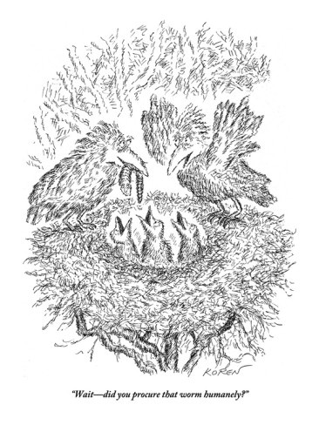
13. Procure: to obtain through special effort; to bring about; gain, acquire
Unit 4
Verb

Slide 15
14. Scurry: to run quickly, scamper, hurry
Unit 4
Verb
The reappearance of the teacher caused the students in the class to scurry back to their seats.

Slide 16
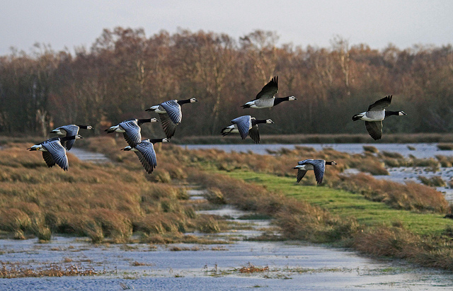
15. Sodden: soaked with liquid or moisture, drenched; dull, expressionless, spiritless
Unit 4
Adjective
All at once, and with much loud honking, the flock of geese rose from the sodden marshlands.

Slide 17
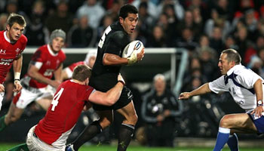
16. Spirited: full of life and vigor; courageous, lively, animated
Unit 4
Adjective
Both teams put up a spirited fight to win the rugby match.

Slide 18
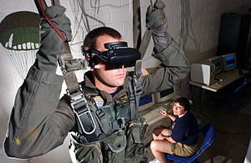
17. Virtual: having a certain force or effect in fact but not in name; so close as to be equivalent to the real thing, functioning as, equivalent to
Unit 4
Adjective
The military uses virtual reality technology to train personnel in such things as parachuting before soldiers do the real thing.

Slide 19
18. Void: adj. completely empty, vacant, bare; having no legal force or effect, invalid; n. empty or unfilled space; v. to cancel or nullify
Unit 4
Adjective
or
Noun
or
Verb
I thought that poem was completely void of sense. (adj.)
Grandmother’s death left a great void in my grandfather’s life. (n.)
Do you know how to void a check? (v.)

Slide 20
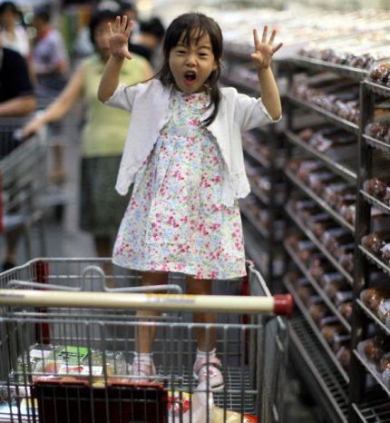
19. Wayward: disobedient, willful; unpredictable, capricious
Unit 4
Adjective
Keeping control of a wayward child is no easy job!

Slide 21
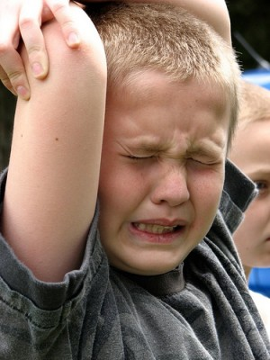
20. Wince: v. to draw back suddenly, as though in pain or fear, flinch, recoil; n. the act of drawing back in this way
Unit 4
Verb
Or
Noun
The bee sting made the child wince in pain. (v.)
The patient’s wince told the doctor to press more gently. (n.)

